Slide 1
The Battery Company Ltd
Introducing the new Duracell Industrial
Available from July 2014

Slide 2
Exclusively Industrial
In July 2014, Procell will be rebranded as
Industrial by Duracell to help consolidate it’s
‘built for trade’ brand
The battery itself will remain the same
excellent standard, but from July 2014 will
benefit from a new look and name

Slide 3
It is made for true professionals
The new brand is being introduced to appeal and
provide clarity for professional customers
Reinforcing its position as the leading choice for
the professional trade – designed specifically for
professionals who need a high quantity of
dependable batteries at a cost-effective price

Slide 4
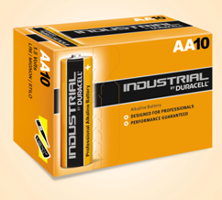
Delivering professional performance
Duracell pride themselves on continually setting
new standard in battery technology – Industrial
by Duracell is no exception
Industrial will perform better in high drain
devices
A new dedicated supply chain to always be
best-in-class for service level in supply

Slide 5
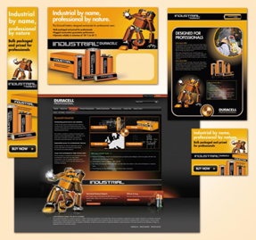
Greater sales and profit opportunities
Industrial by Duracell the new professional
battery of choice
Helping drive sales towards professional
channels
A full range of support material to help
generate greater sales and profit
opportunities

